Slide 1


Slide 2
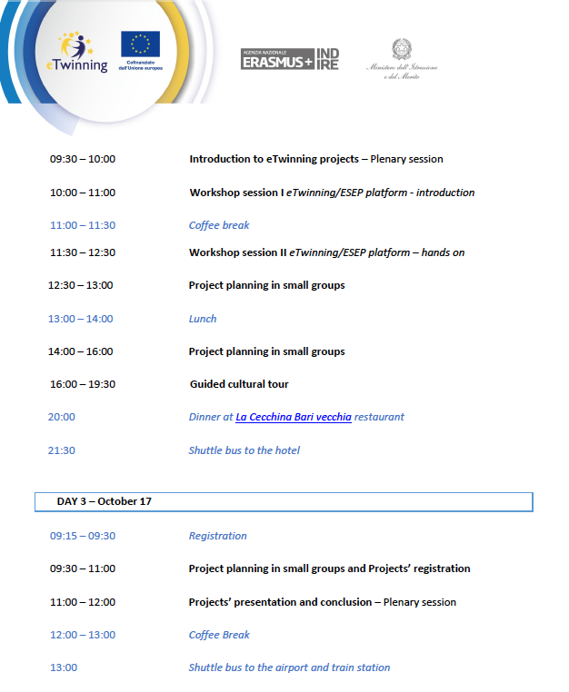

Il programma dell'evento

Slide 3
L'intervento della Professoressa
Anna Andriulo
ICS Carducci – Materdona, Mesagne (Italy)
Che ci ha illustrato il suo progetto vincitore del premio e-Twinning best practices presentation-presentazionebariott2025-anna-andriulo

Slide 4
Il link per accedere al seminario a cui ho preso parte https://etwinning.indire.it/eventi/skills-for-life-a-bari-seminario-bilaterale-italia-francia/
La pagina da consultare per candidarsi a webinar o eventi
di formazione sia a distanza che in presenza
https://etwinning.indire.it/formazione/#eventi-futuri

Slide 5

Tutorial per iscriversi ad e-twinning
https://www.youtube.com/watch?v=jgFFVqfrAJo

Slide 6
Nelle prossime slide, una breve presentazione del progetto fondato con i partner francesi ed esposto durante l'ultima fase del seminario

Slide 7
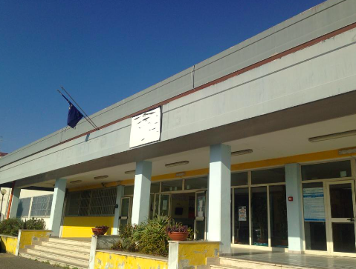

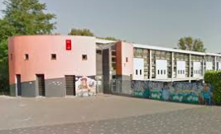
Gli Istituti coinvolti
SS I° Gramsci-Impastato di Giugliano in Campania (NA)
Anna Poziello
French teacher in Italy
Collège Saint Louis de Villemomble (93)
Namy Ly
English teacher in France
Collège Rosa Parks d’Amiens (80)
Pauline Gaillet
Italian teacher in France
Une école sans frontières
Scuola senza confini
School without borders

Slide 8
Age of pupils and classes involved 11-12 ans
Anna : Seconda (5ème) 16 élèves Pauline : 5ème /4ème 21 élèves Namy : 5ème 34 élèves
How do my peers live in other countries?
This is the question the French students from SS I° grado Gramsci Impastato in Giugliano in Campania (NA), the English students of Collège Saint Louis in Villemomble (93) and the Italian ones of Collège Rosa Parks in Amiens (80) are going to answer by discovering their e-Twinning penpals' work and by challenging themselves with a kahoot.

Slide 9
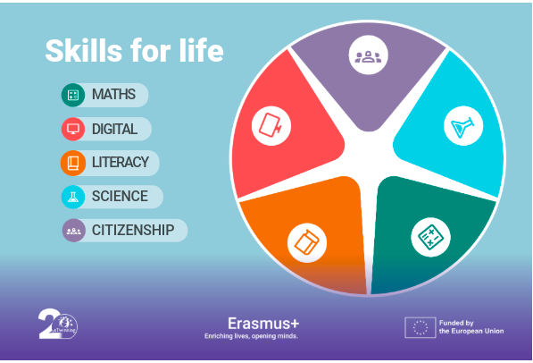
Main topic
Comunication, forein Language and Critical reading
-Use digital technologies safely, critically
-communicate with partners in an international cooperation
-develop a critical reflection on different cultural context
The goal is to
develop these three
Skills for life
giving them a voice to
tell their story and by comparing
Their liver to that of other European students

Slide 10
4 STEPS
Step 1: Introduce yourself through play (2 hours) During the teachers' classes: - Who is it? Physical description and expression of interests (passions, hobbies, etc.) for each student, either orally or in writing, to help the etwinning partners guess their identity based on a group photo taken by the teacher and an association sheet. Use of the DIGIPAD and etwinning websites. Evaluation of student work by the teachers. (Nov-Dec)
Step 2: Present your school (the premises) in the target language on the Etwinning website to your pen pals (3 hours) Create a virtual tour of each school to be published on Etwinning using a MADMAGZ link (create a trilingual magazine with photos and an article) Objective: Create trilingual signs based on the virtual tours viewed and display them in the respective schools for Language Week and Open Day. Common work (Jan-Feb)
Step 3: Present their school life (rhythm, activities, etc.) in the target language on the Etwinning website (3 hours) Distribute tasks to student groups (recess, subjects studied, timetables, cafeteria, UNSS, etc.). Each group creates their own short narrative with an avatar to create a "virtual guide" video using HEYGEN AI. Publish the videos on the Etwinning page. (April)
Step 4: Joint Final Project (2 hours) Creation of a joint trilingual quiz based on all the material learned using Kahoot, evaluated by the teachers. Each class prepares seven questions, having previously assigned themes. A half-hour video conference to complete the quiz together and explore the podium together and the 3 winners get a prize from e-twinning. (May)

Slide 11
Dissemination
Open day
Week of forein Langages
Publication on the school website
Sharing with colleagues
Evaluation
Step1 speaking test
Step2 writing test (creation of a page)
Step4 interactive speaking and quiz Kahoot

Slide 12
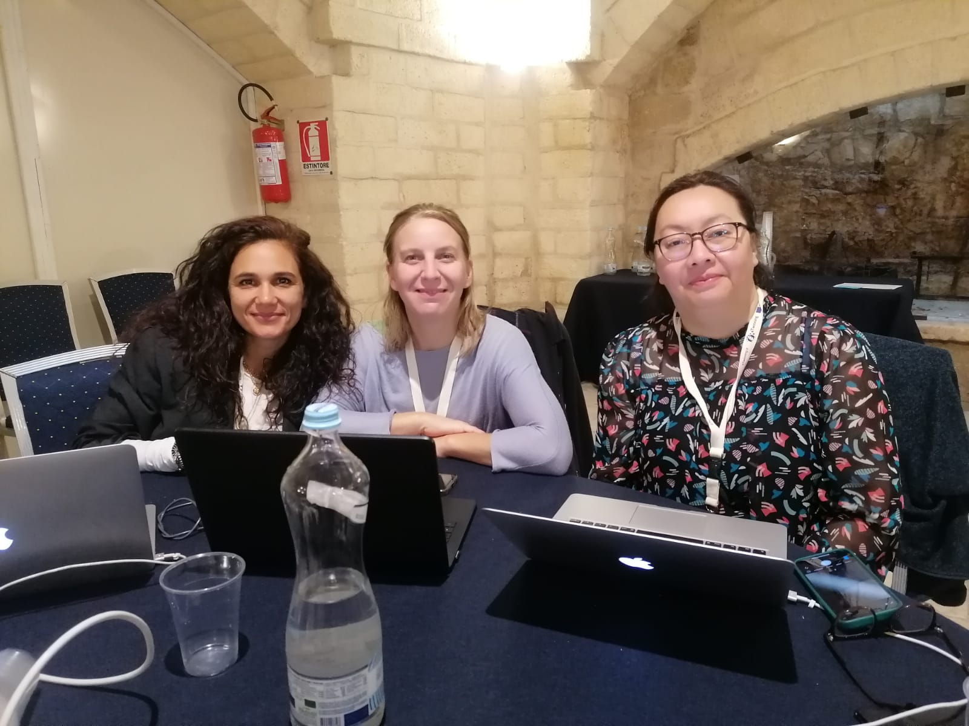
Grazie Thank you Merci

